Slide 1
Arcane Programming
The stylish solution to managing your video game library

Slide 2
What had we set out to do?
Simplicity
Color
Beauty
Reliability

Slide 3
Has it worked?
Let’s find out!

Slide 4
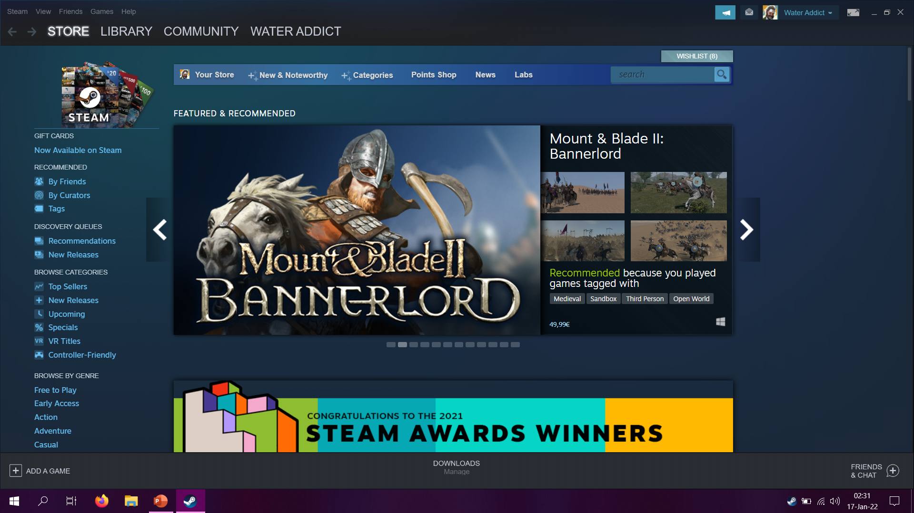
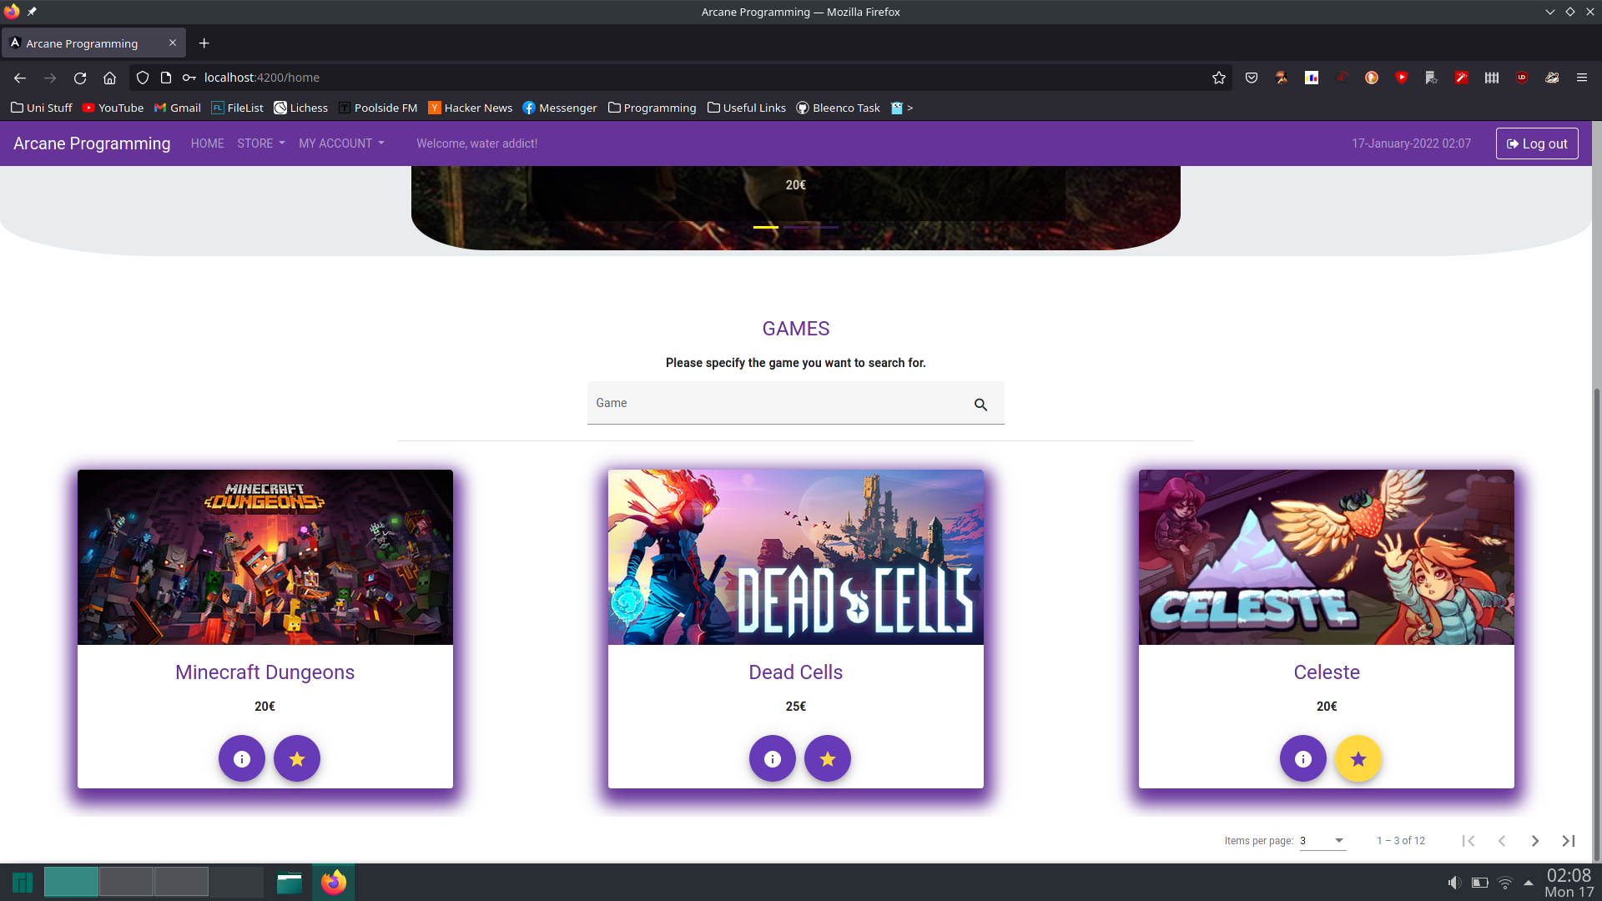
Store page
Clutter, choice fatigue
Straight to the point

Slide 5
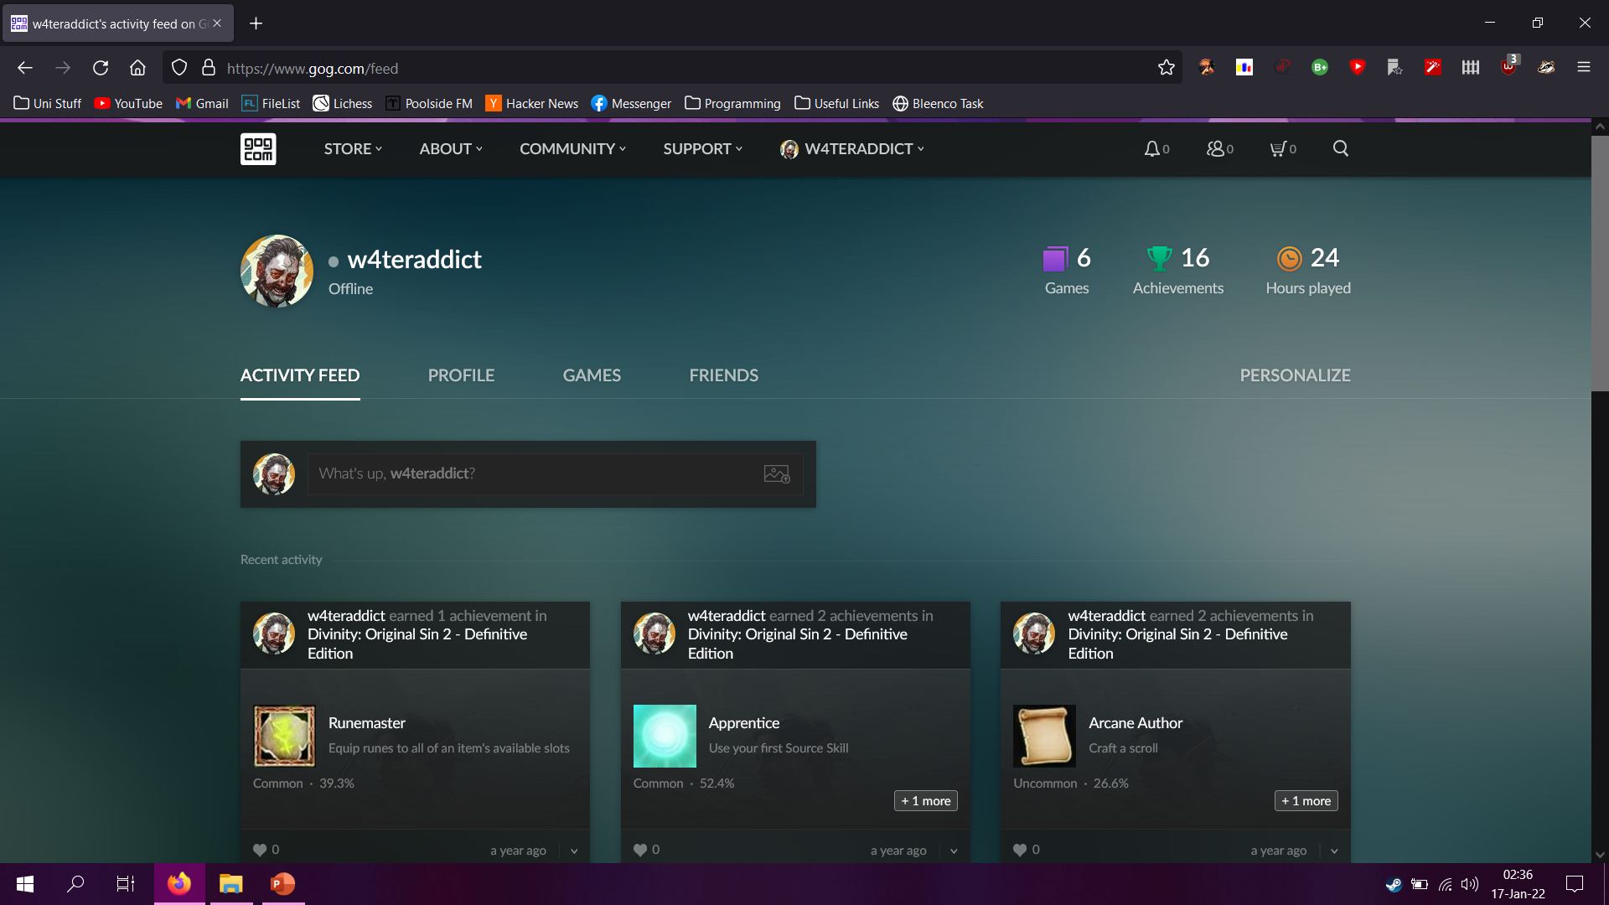
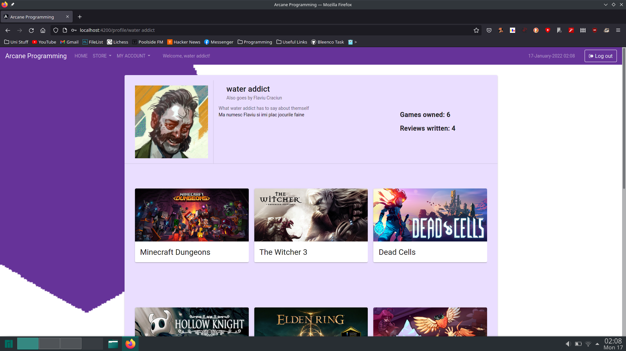
Profile page
Flat, safe colors
Vibrance and boldness

Slide 6
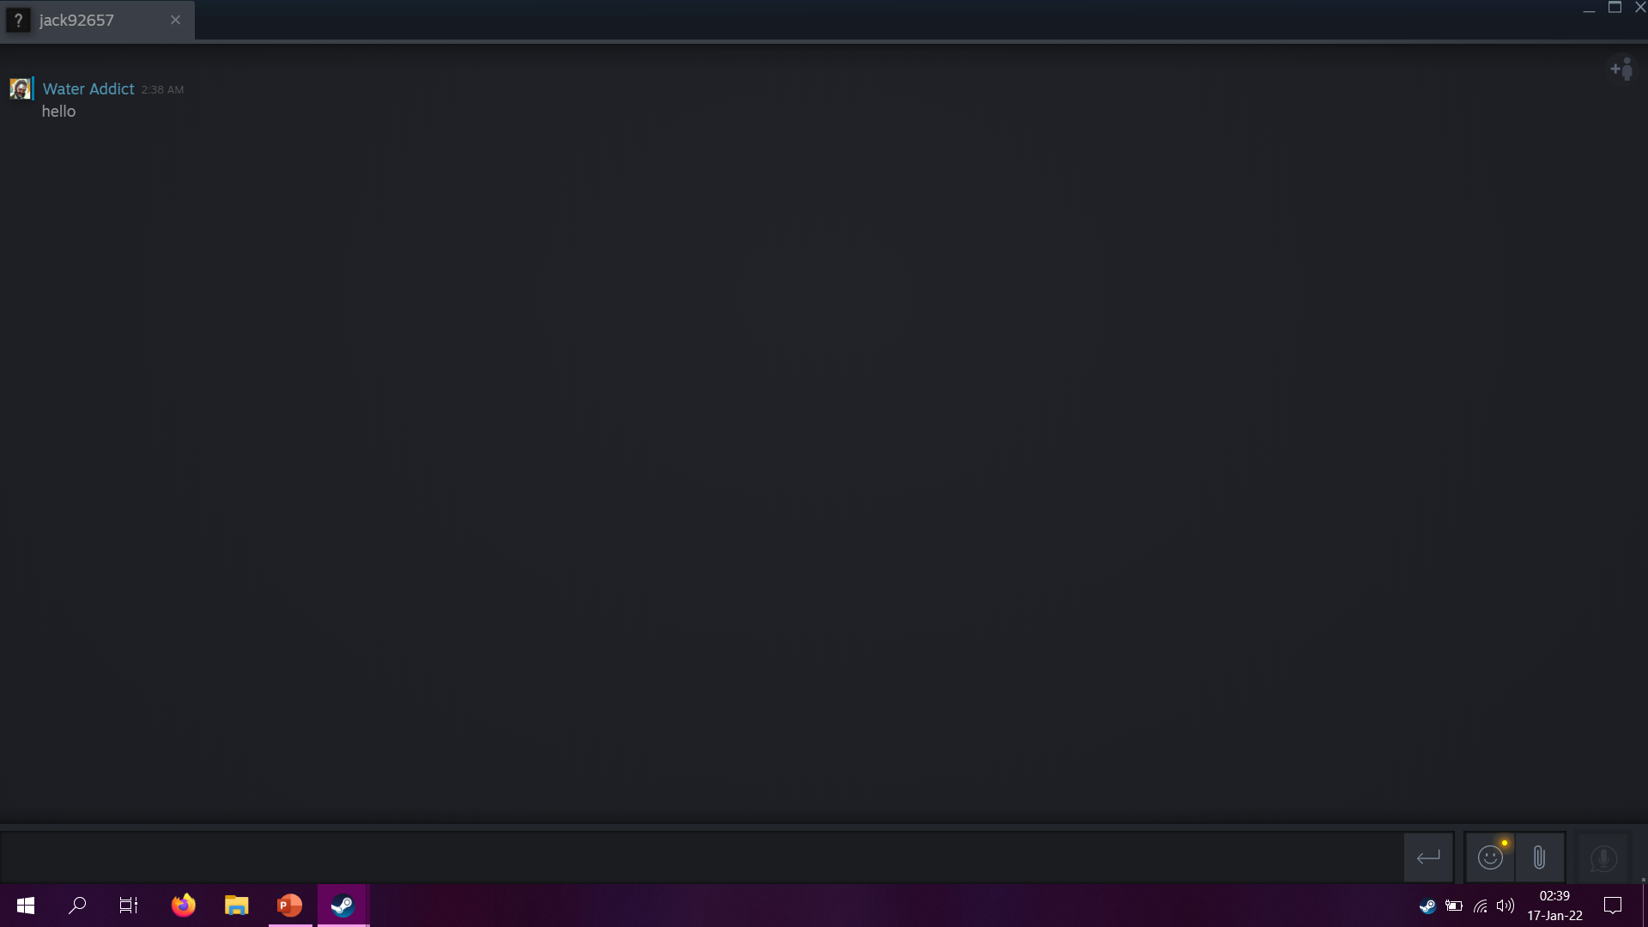
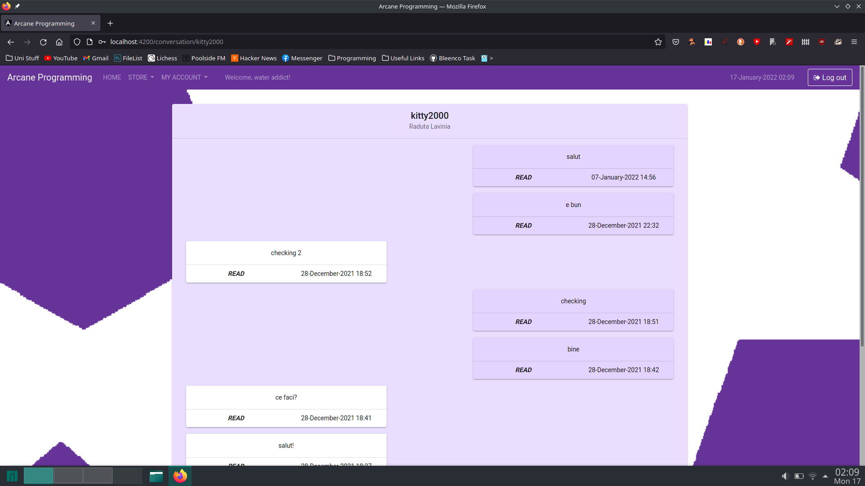
Messaging
Wasted real estate
Ample space used

Slide 7
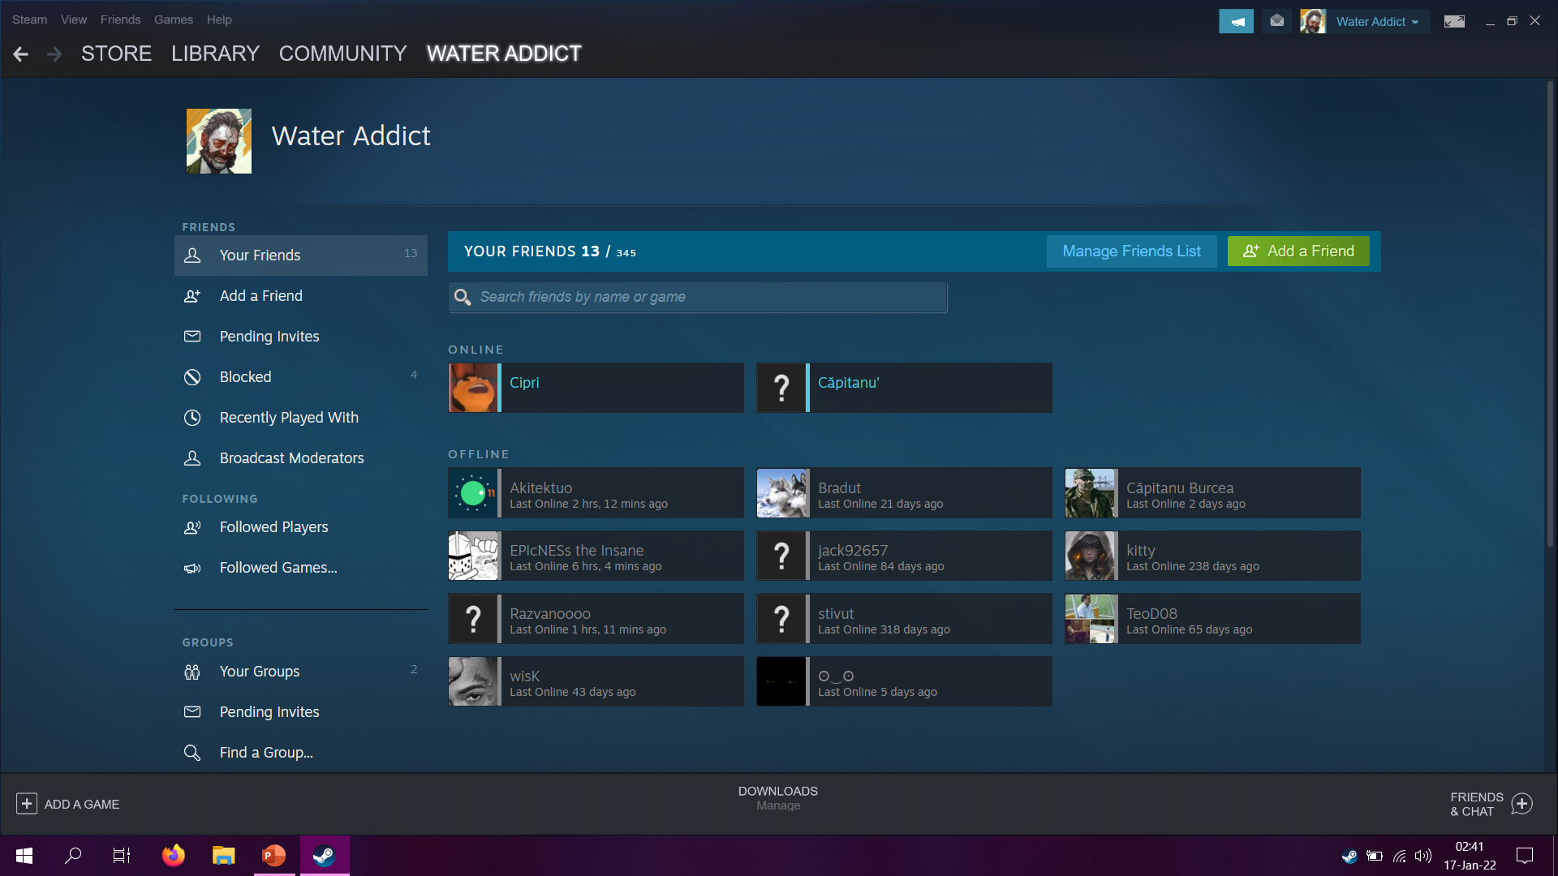
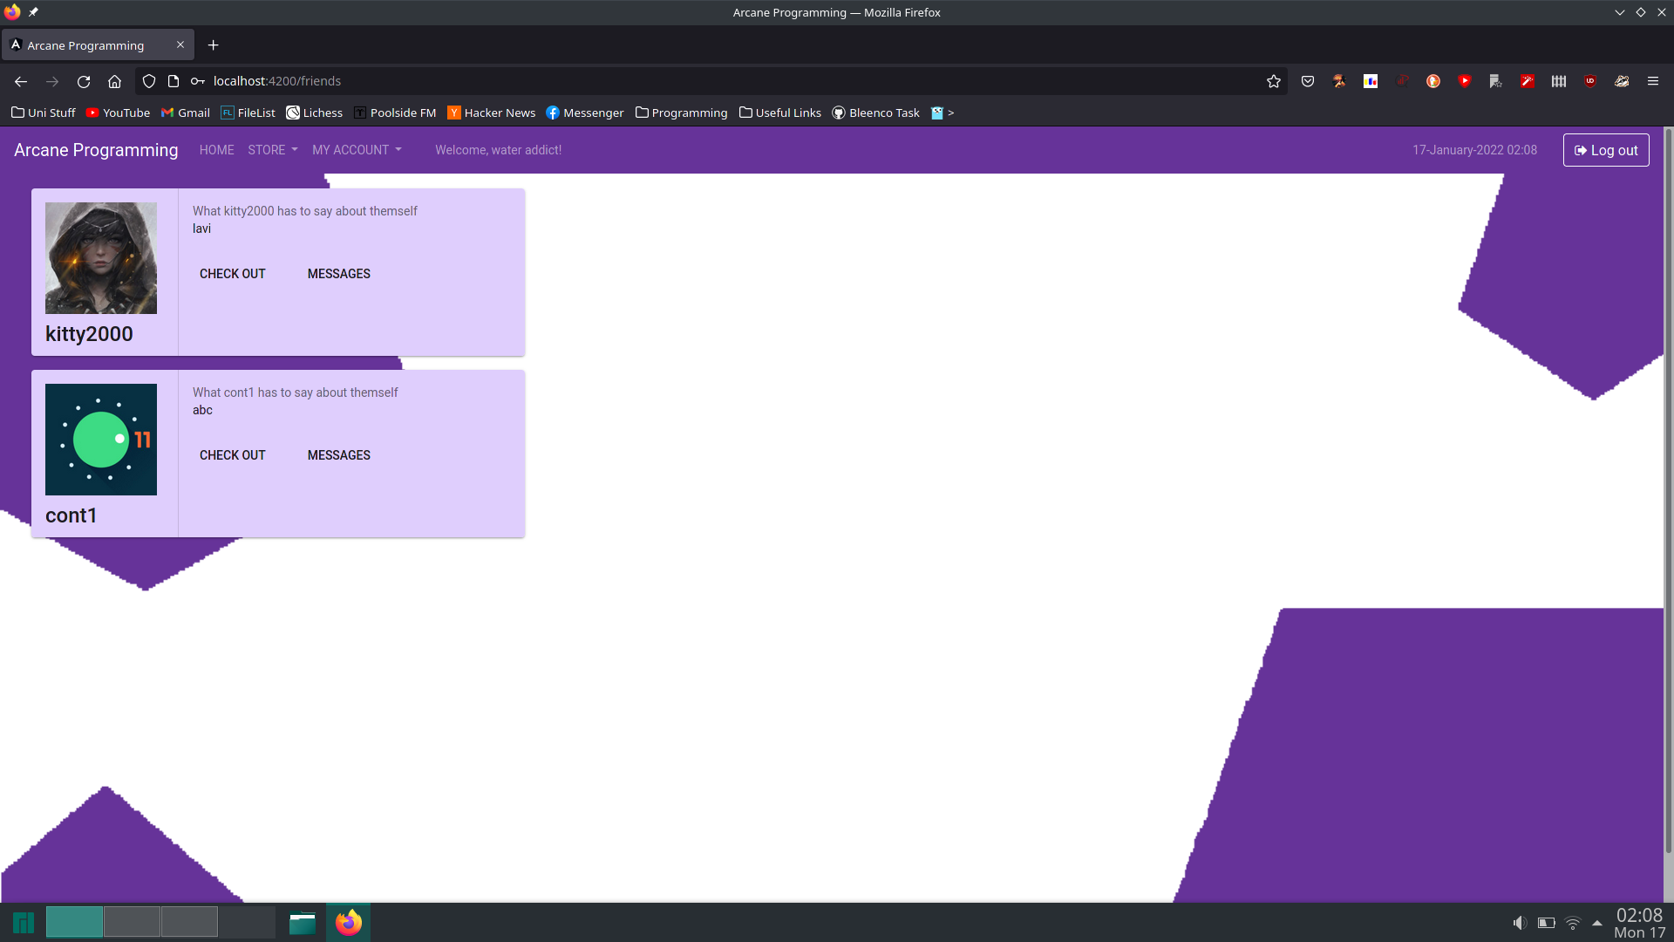
Friends page
What do all these buttons do?
Need friends? Just friends

Slide 8
What comes next?
More basic functionalities
Game hubs
Recommendations based on user taste
Streaming integration
Groups
More personality, refined appearance
The sky is the limit

Slide 9
Care for a demo?
Walk with us through the app!

Slide 10
The team that made it all possible!
Craciun Ioan Flaviu
Raduta Lavinia-Elena
Suciu Daniel
Zavorodnic Andrei
Tirdea Razvan
Tibre Diana
Sustic Alex

Slide 11
Thanks for the awesome semester!
We all had great fun developing our application!

